Slide 1

DSC680 - Depression or Cyberbullying Sentiments from Twitter
Joshua Burden Bellevue University 04/02/2023

Slide 2
Introduction
Notes:
In the first term project I chose to examine the topic of depression and cyberbullying using various research papers and datasets found from Kaggle and other resources. The purpose would be to extract meaningful insights into the data by exploring the datasets, and to build a meaningful model to find NLP sentiments that can help predict cyberbullying and early warning indications of depression through social media.

Slide 3
Business problem
Depression is common.
Depression can be debilitating, disabling, and/or defeating.
Depression is very curable.
Online harassment could be the reason.
Notes:
Depression is one of the most prevalent mental illnesses that can be very debilitating, disabling, defeating, but is very curable. It is underwhelmingly undiagnosed, and has a tendency to be created or otherwise increased in intensity due to either online harassment, or negative feedback loops perpetuated from various forms of social media such as Facebook, Instagram, or twitter. With the current downsizing and purchases of platforms, there is a combination of conversation being had if social media is free, and safe. I am looking at the data points of social media’s safety as there is plenty of evidence to suggest that social media helps increase the amount of depression that could be encouraged due to the amount of cyber bullying.

Slide 4
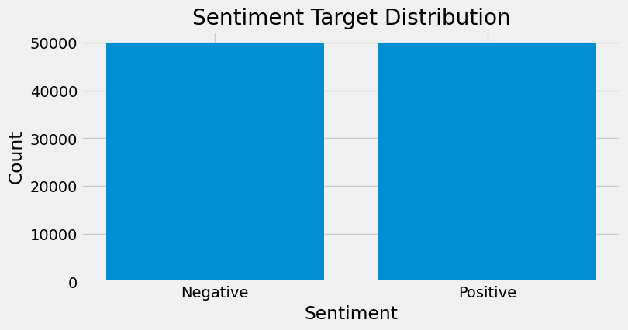
Findings
Notes:
When evaluating the data there were many discoveries found throughout the data. The first thing that needed to occur to make this data work was to clean it properly. It was prudent that the data be checked for proper format and to begin analysis on the different datasets. From three data sets, an extraction of information was gathered. From the first dataset a sentiment target distribution was created using 100,000 tweets and was equally divided between values of Negative and Positive.

Slide 5
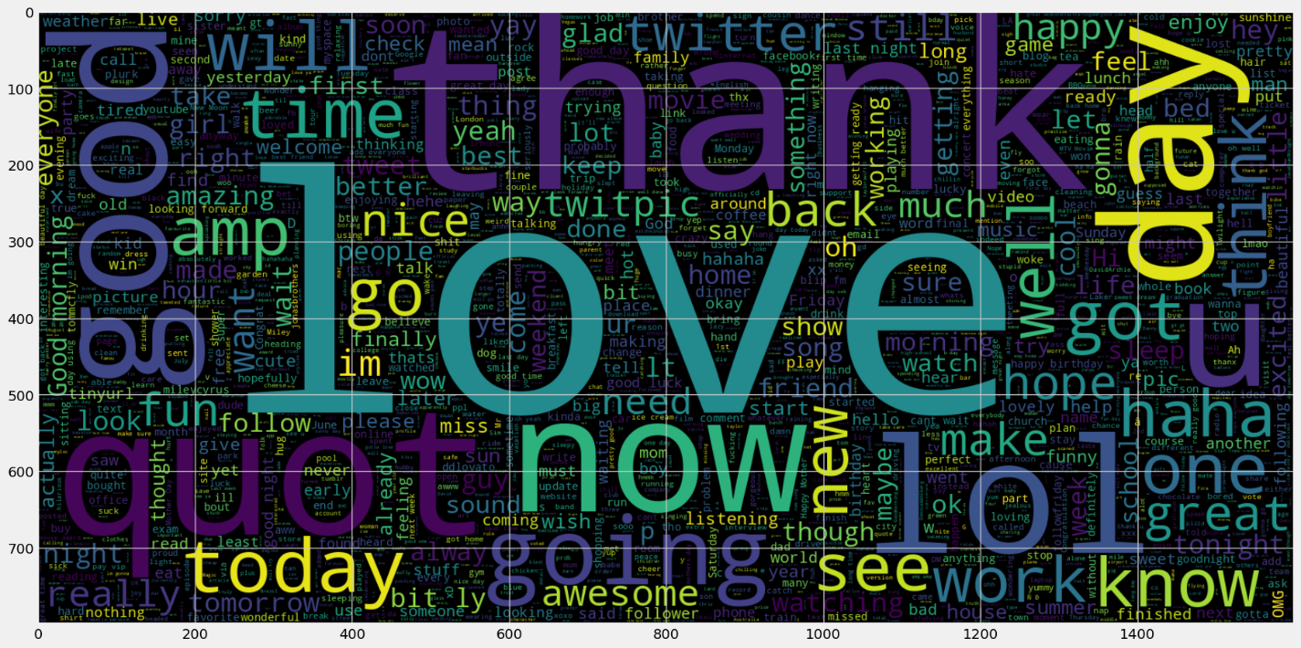
Notes:
From the Twitter sentiments a word cloud was formed to see the top words that were found in Positive tweets. This produced a word cloud of the top words used in all the positive sentiment tweets. Commonly found words in tweets that were considered positive, or convey a positive sentiment were ‘Love’, ‘thank’, ‘now’, ‘lol’, ‘good’, ‘going’, ‘day’, ‘think’, ‘awesome’, and so many more.

Slide 6
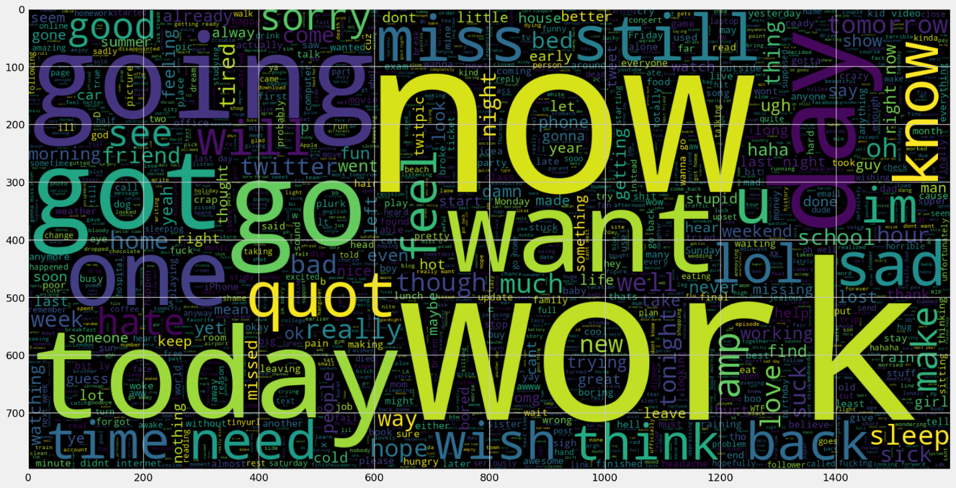
Notes:
Negative sentiment analysis word cloud produced results that had a more bleak outlook. Common words were now, work, going, got, go, today, miss, think, need, and many others. A word cloud was produced to represent the negative tweet sentiments.

Slide 7
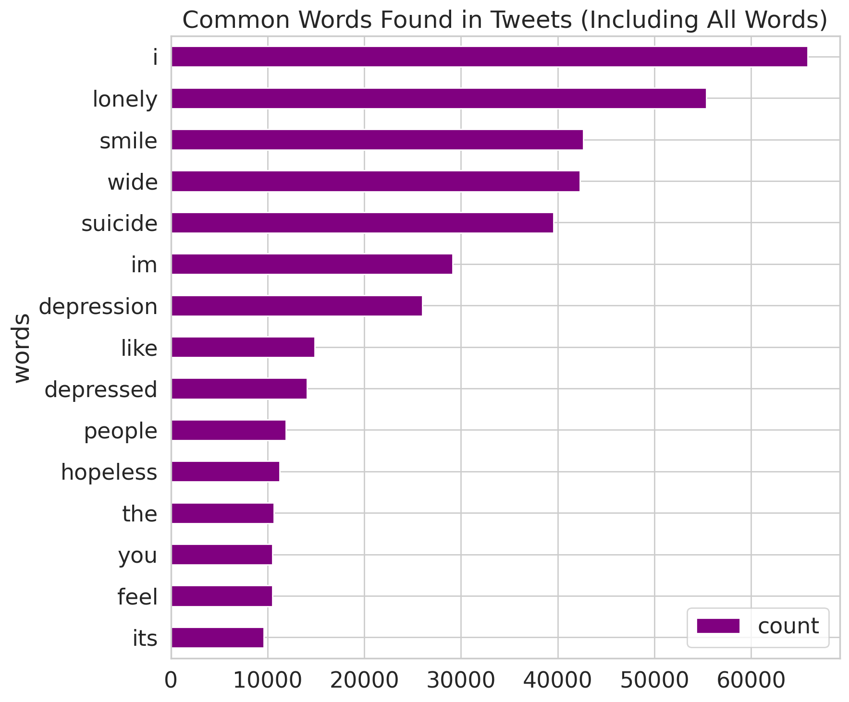
Common Words Found in Tweets (including All Words)
Some commonalities were found among all tweets as well. These words were found often all the tweets regardless of the stop words.

Slide 8
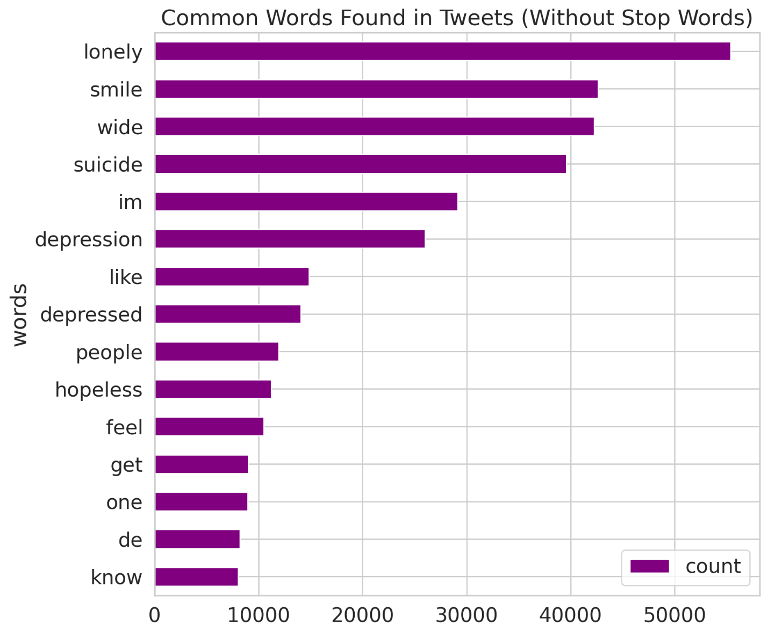
Without Stop Words
When we begin to filter out “stop words”, words that are commonly found in a language, we start to see a different set of words that are more common. If we exclude the words ‘im’ and ‘wide,’ we are left with a top five words in tweets: lonely, smile, suicide, depression, depressed. This indicates that there is more likelihood of a depressive person on the end of a tweet than there are a person who is experiencing a good disposition

Slide 9
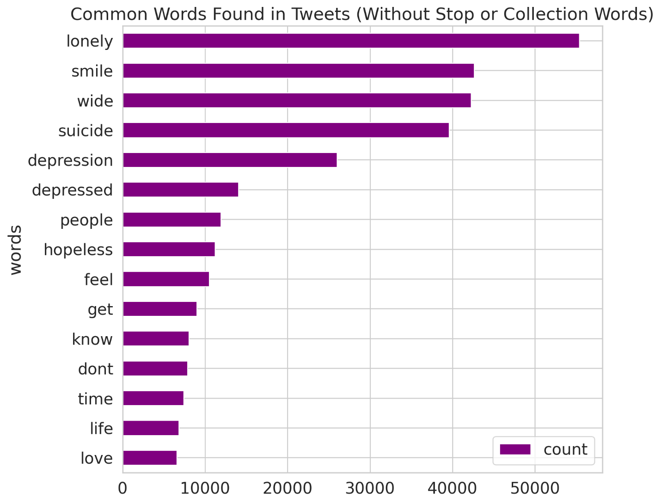
Without stop and collection words
Without stop and collection words, filtering out the collection words creates the same type of appearance as above but without the filler words or words such as ‘de’. It also added more words after ‘know’, such as ‘don’t’, ‘time’, ‘live’, and ‘love’. The rational for this is that though most are depressed and tend to be a larger makeup of the tweets created, the opposite side of depressed tweets begin to bubble up as either neutral words, descriptive, or positive sentiments.

Slide 10
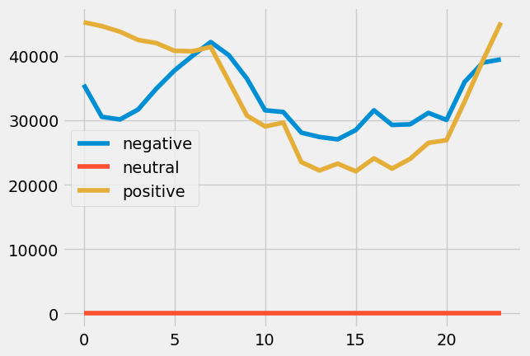
When the data is generalized and the number of tweets is considering and giving a positive, neutral, or negative value of sentiment based on time, we can see something interesting happen. From adding the data in the range of a 24-hour period, positive tweets start at a high point at the 00:00 mark, while negative tweets while lower than positive tweets, trend downward, and then begin having a massive uptick right around 02:00, and when most people are beginning their day, around 6:00, positive and negative tweets are around the same point. Throughout the day, we see that negative tweets and positive tweets both tend to track downward in count, but negative tweet sentiments continue to stay about positive tweets. At 20:00 we see something interesting again, we see a massive uptick in positive tweet sentiments, and a massive uptick in negative uptick sentiments as well.

Slide 11
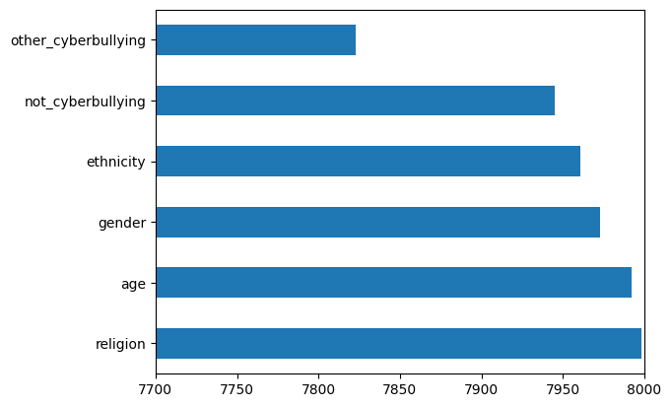
Cyberbullying
Notes:
When it comes to cyberbullying the data set produced several different sentiments broken up by Gender, Race, Religion, Ethnicity, and what would be classified as ‘other’ kinds of cyberbullying. From exploring this dataset, there were a fair share of cyberbullying values that were often used in negative tweet sentiments. Using the dataset cyberbullying_tweets.csv, a list of labels was found to be unique in the cyberbullying_type column:

Slide 12
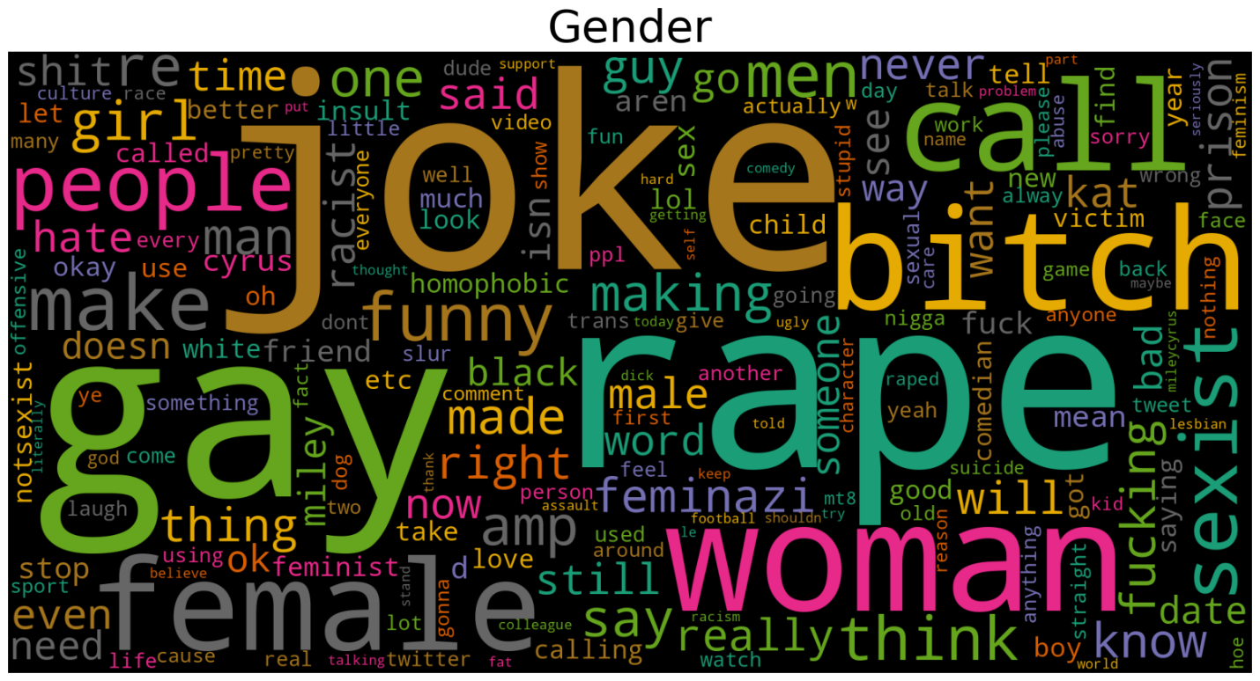
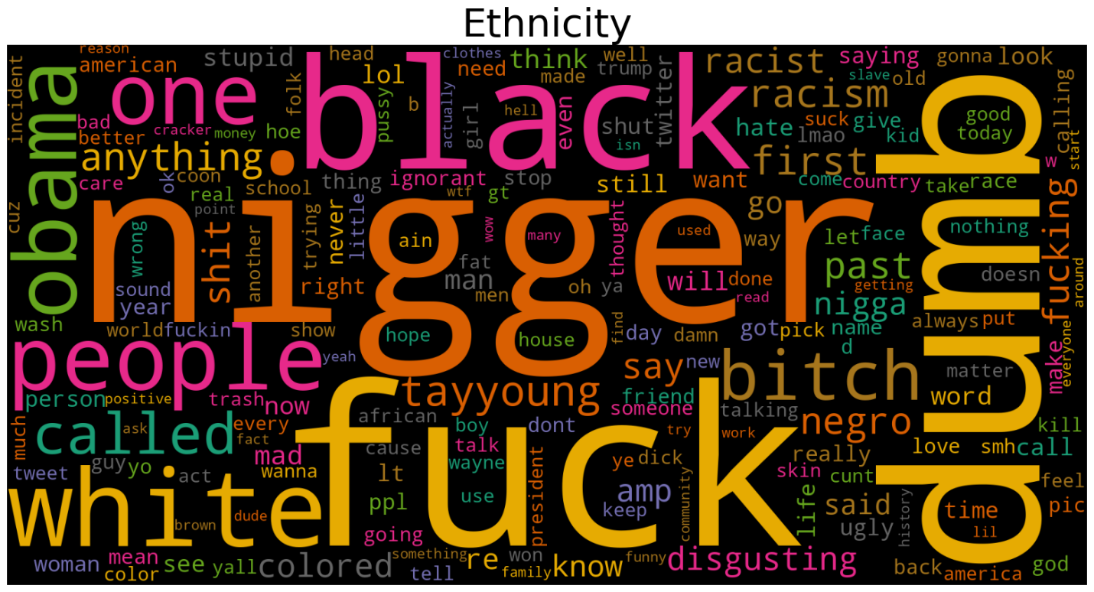
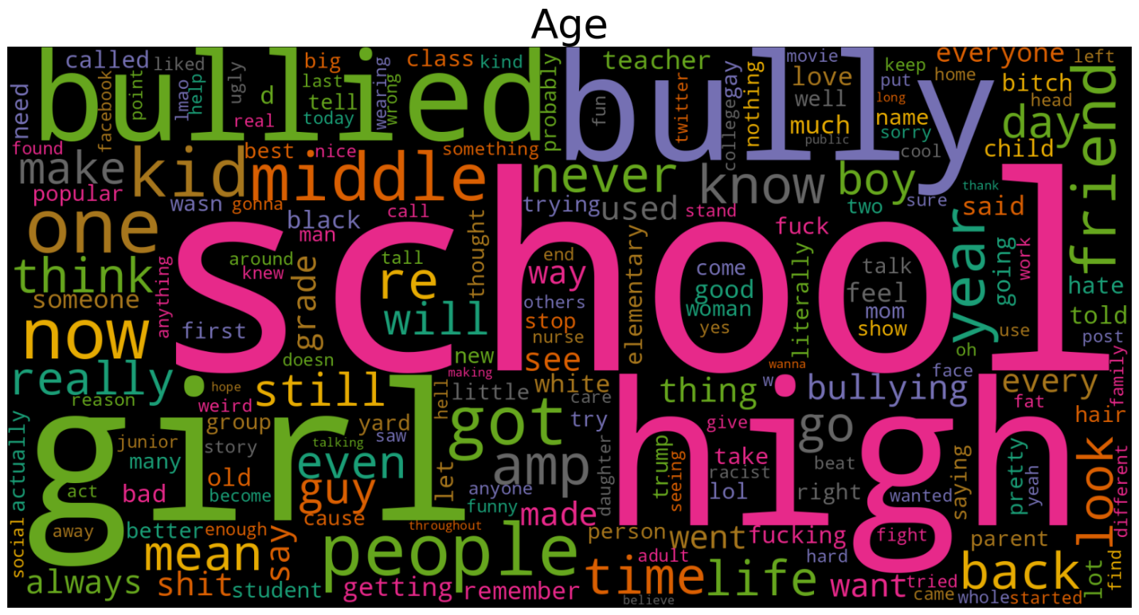
Notes:
Of the different labels created, it was easy at this point to build some word clouds of the most common words that were used based on the unique label’s column. After adding an update to the stopwords, we were left with a word cloud for each unique type.

Slide 13
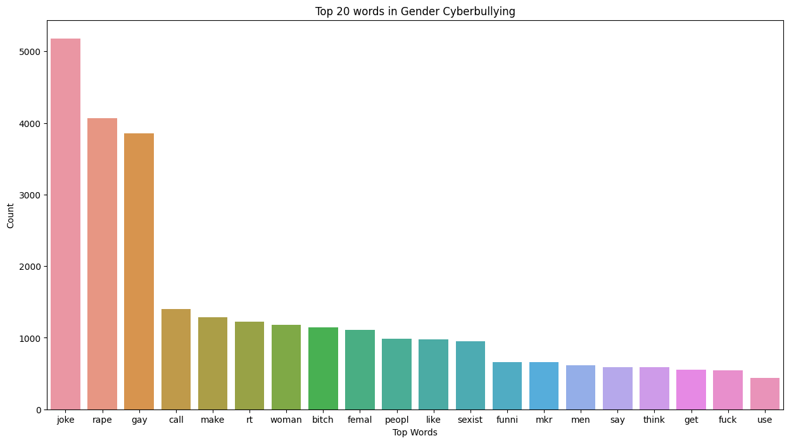
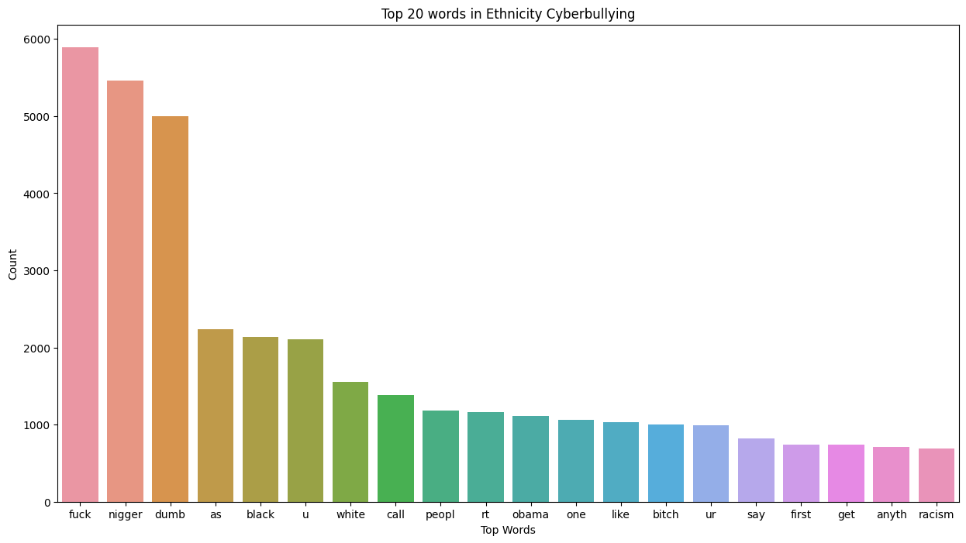
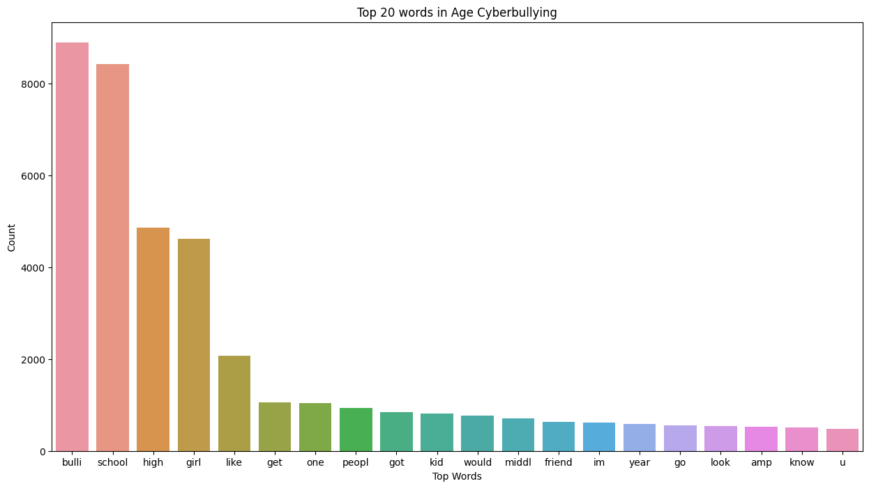
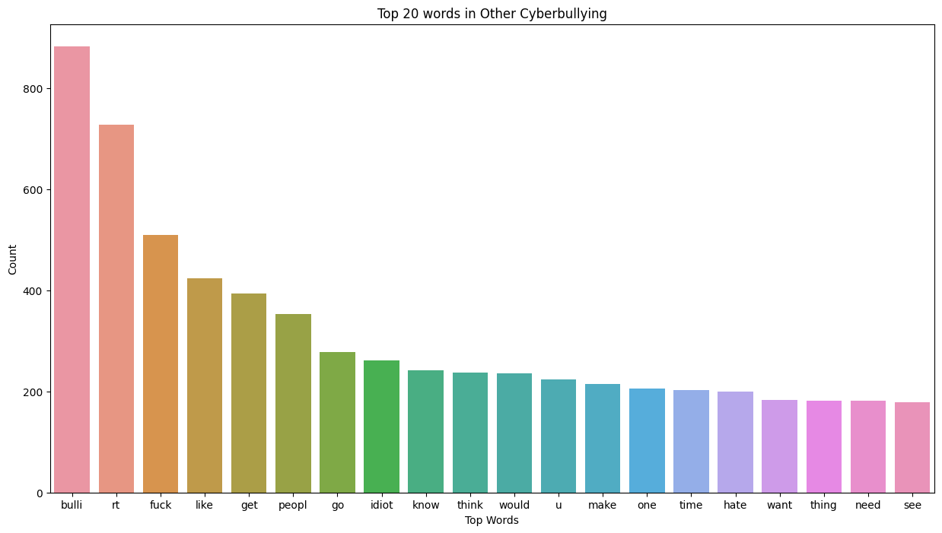
Notes:
From what it would look like, there is quite a bit of negative sentiment towards gays, females, blacks, Muslims, Christians, but unsurprising was a large set of words from sets that had the word ‘bulli,’ and the next word in Age was ‘School.’ There is a safe estimation that cyber bullying tends to target those who are women, gay, black, of a certain religion such as Christian or Muslim, but when it came to age, those who are bullied the most are in a school setting and are female.

Slide 14
Conclusion
Notes:
From exploring the data, most people on the internet are depressed. While bullying online does seem to have an impact on some demographics, the takeaway for depression was less about bullying and more about time of day, and what people experience at or after work. Those who are online and tweet tend to tweet negatively over the course of a day, which could be caused by a myriad of reasons, but the words that appear most are related to ‘work’, ‘going’, having a relation to time such as ‘yesterday’, ‘today’, ‘hour’, and depressive words like ‘bad’, ‘miss’, ‘sad’, ‘want’, and ‘sorry’ or states of mind such as ‘bored’, ‘great’, and ‘suck’. Though not conclusive, depressive states of mind could be an early warning sign of stress caused by work or time related stress.

